Slide 1

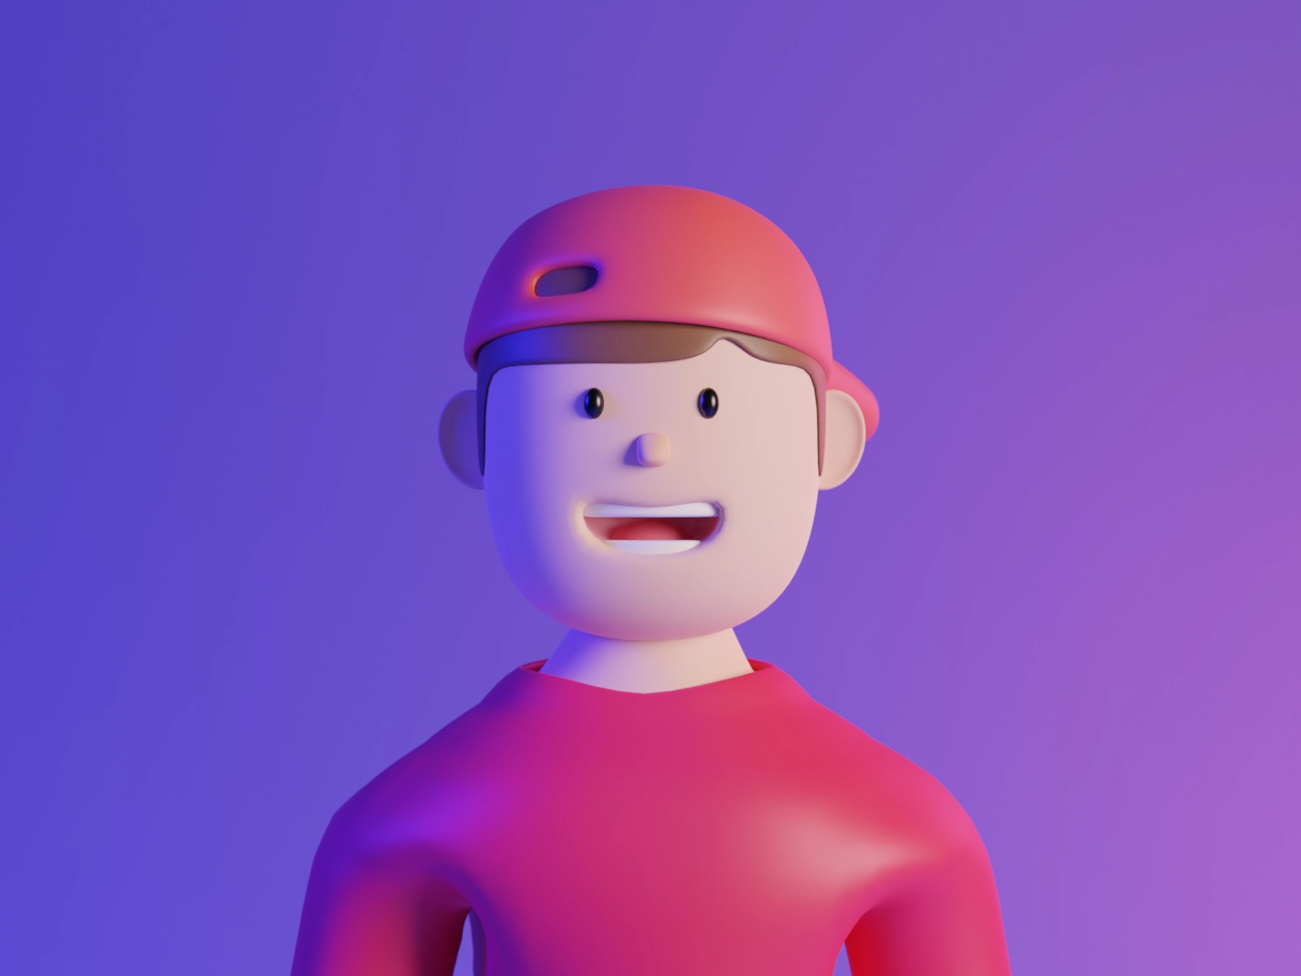


Inspired by Style Teyvat
FLEETING
Tekejut
Tengok teaser Genshin impact Teyvat style dengan music dia terus inspired untuk buat style macam ni.
COLORS IN
FLIGHT
WELCOME
Tengok teaser Genshin impact Teyvat style dengan music dia terus inspired untuk buat style macam ni.

Slide 2

Points
Menus
Home
hmppt
Inspired by Style Teyvat
FLEETING
Tekejut
Tengok teaser Genshin impact Teyvat style dengan music dia terus inspired untuk buat style macam ni.
COLORS IN
FLIGHT
WELCOME
Tengok teaser Genshin impact Teyvat style dengan music dia terus inspired untuk buat style macam ni.

Slide 3




Design by
hmppt
CBRE
Home
Menus
Points
PENSEL
LOKEY
Tengok teaser Genshin impact Teyvat style dengan music dia terus inspired untuk buat style macam ni.
Tengok teaser Genshin impact Teyvat style dengan music dia terus inspired untuk buat style macam ni.

Slide 4



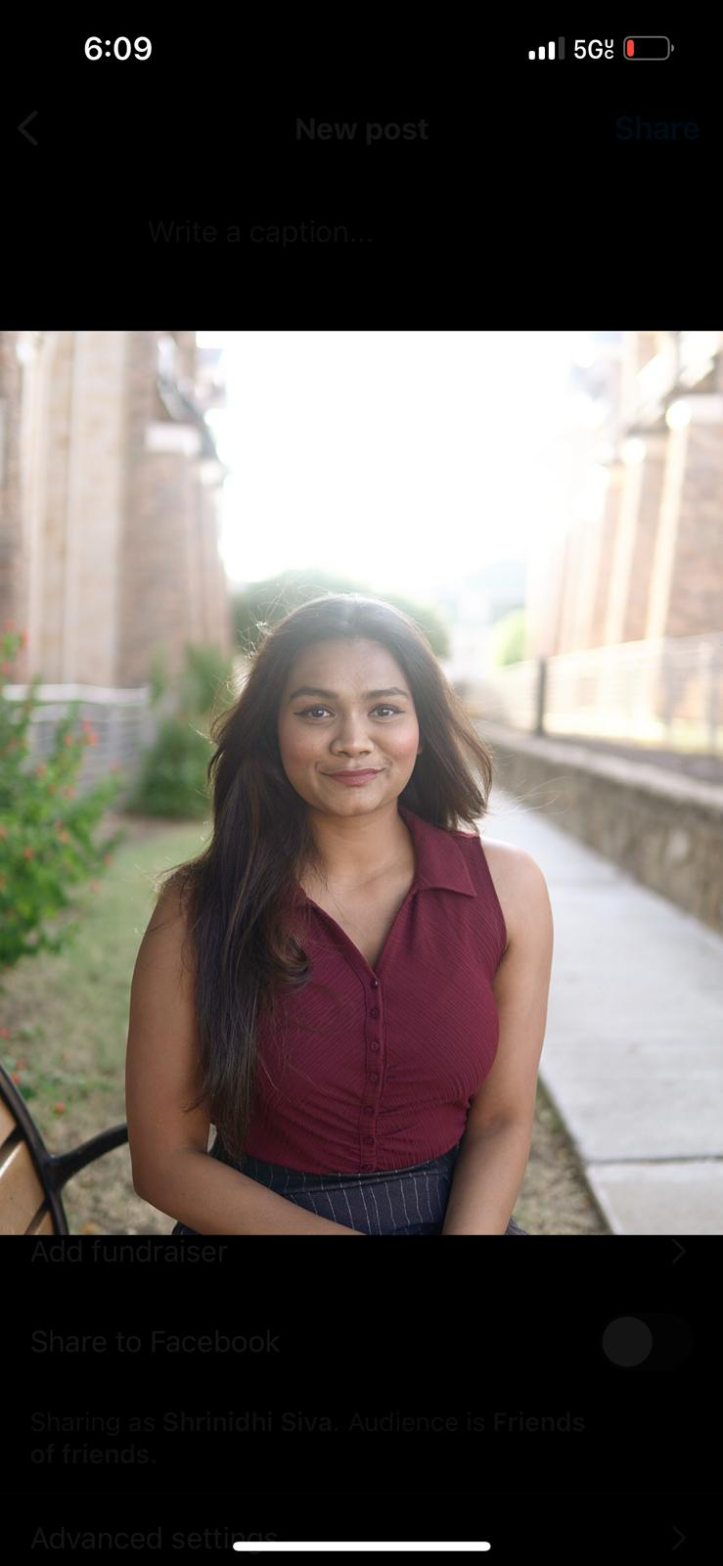

CBRE
Home
Menus
Points
Our
Team
Veera Venkata Sairam Dasari
Darshil Patel
Shrinidhi Sivashanmugam
Vishal Vimal Kumar

Slide 5
CBRE
Home
Menus
Points
STYLE
Our
To Display Insights relevant to Users
Objectives
OF
TeyVAT
Ranking the given insights

Slide 6
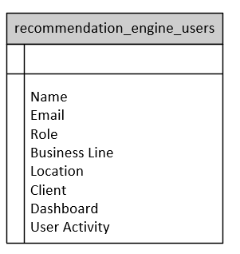
CBRE
Home
Menus
Points
Rules
Based Approach

Slide 7
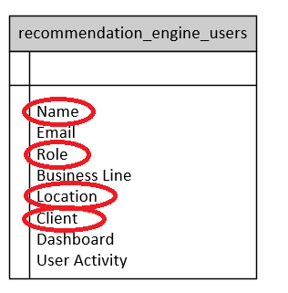
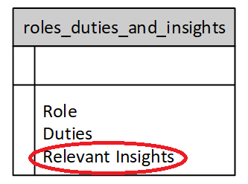
CBRE
Home
Menus
Points
Work
Flow

Slide 8
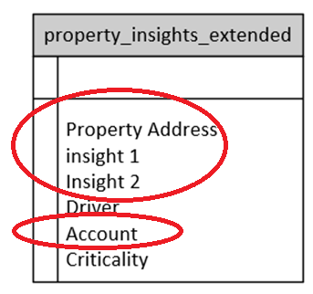
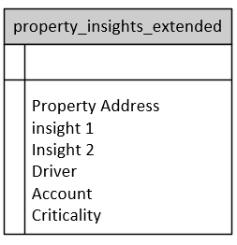
CBRE
Home
Menus
Points
Work
Flow

Slide 9
Python
Pandas
Flask
HTML/JS
CBRE
Home
Menus
Points
Rules
Based Approach

Slide 10
CBRE
Home
Menus
Points
Inspired by Style Teyvat
Content-based filtering
Content-based filtering is a recommendation system technique that suggests items to users based on the characteristics and content of those items, rather than relying on user interactions or collaborative filtering. It analyzes the properties or features of items and recommends similar items to users based on their past preferences.
FLEETING
ML
GRADIENT
COLORS IN
Approach
IN TEXT
FLIGHT
WELCOME
Tengok teaser Genshin impact Teyvat style dengan music dia terus inspired untuk buat style macam ni.

Slide 11
CBRE
Home
Menus
Points
Inspired by Style Teyvat
FLEETING
GRADIENT
Unsupervised Approach (cosine similarity approach)
Supervised Approach
COLORS IN
ML Approach
IN TEXT
FLIGHT
WELCOME
Tengok teaser Genshin impact Teyvat style dengan music dia terus inspired untuk buat style macam ni.

Slide 12
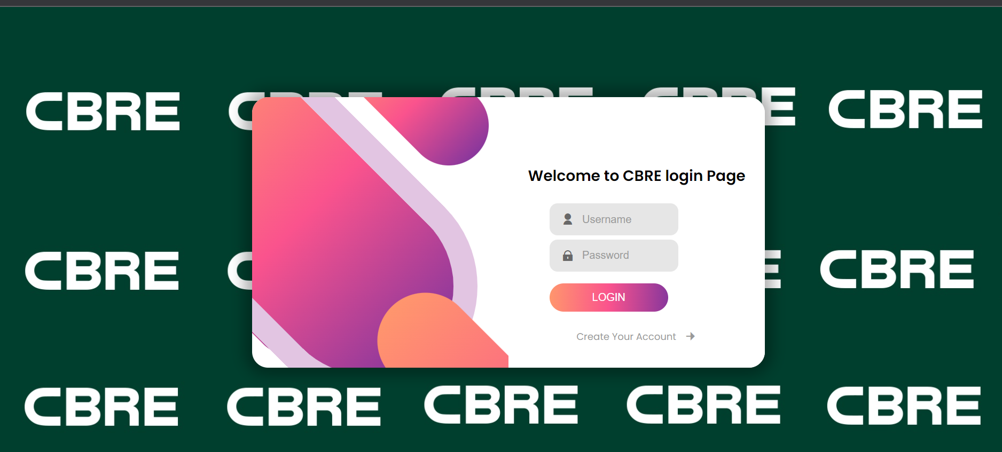
CBRE
Home
Menus
Points
Inspired by Style Teyvat
FLEETING
GRADIENT
COLORS IN
UI design
IN TEXT
FLIGHT
WELCOME
Tengok teaser Genshin impact Teyvat style dengan music dia terus inspired untuk buat style macam ni.

Slide 13
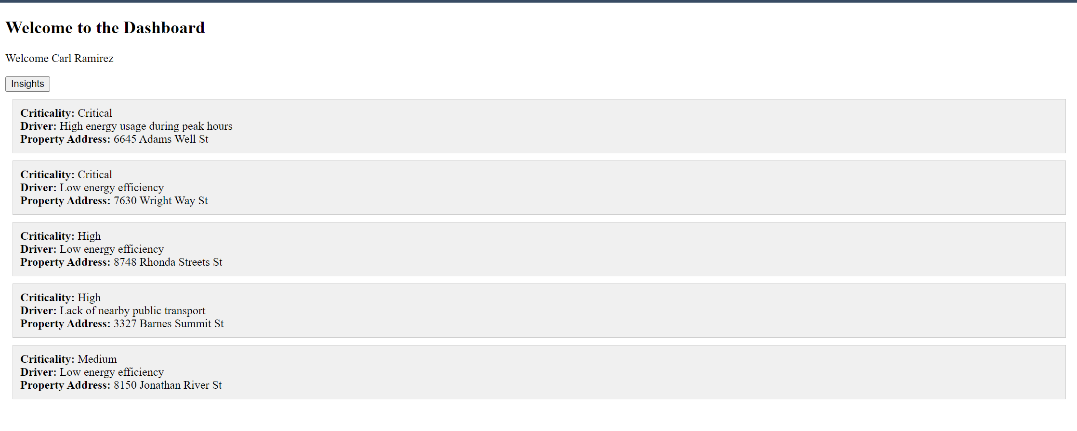
CBRE
Home
Menus
Points
UI design

Slide 14
We were able to find relevant insights using a rule-based approach.
We were able to find insights using an ML algorithm, but the accuracy is low.
We were able to set up a server and create a working UI to display the relevant insights.
CBRE
Home
Menus
Points
Conclusion

Slide 15
Points
Menus
Home
hmppt
Thank
GRADIENT
Tekejut
LOKEY
You
PENSEL
Tengok teaser Genshin impact Teyvat style dengan music dia terus inspired untuk buat style macam ni.
Tengok teaser Genshin impact Teyvat style dengan music dia terus inspired untuk buat style macam ni.
Tengok teaser Genshin impact Teyvat style dengan music dia terus inspired untuk buat style macam ni.
IN TEXT
Any Questions ??

